Slide 1
Goodwill ministries africa goodwillministriesafrica.org
Team Guide

Slide 2
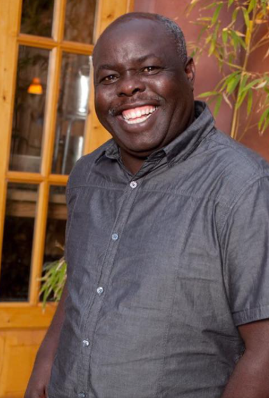
Edward Mbuyi - president of Goodwill Ministries africa
Rev. Edward Mbuyi, native of Kenya, serves as the President of Goodwill Ministries Africa. He grew up in Kenya, with his family, while they served with African Inland Mission. He studied at Diguna Missionary College in Kenya and then Abiola Bible School in the UK. He was granted a scholarship to Oxford University, England and graduated in 2003, with his Masters of Theology.
Edward felt Gods call to serve in Uganda in 2008 via a dream. He recalls a dream with a torrential rain. The rain was collecting and causing massive floods. The rain continued and people were becoming scared that they would be swept away. Everyone was crying and panicked. He notes that he too was crying in the dream and thought the rain was going to kill everyone. He woke up shaken and cried out to the Lord. The Lord said to him that “people are praying for revival but if it comes now, it will only destroy them because they are not ready. It will wash over them like a flood and destroy them. If no Godly leaders know the word of God, the spirit will come but no one will understand it.”
Edward accepted this call to ministry in Uganda. He knew he was to train pastors. He refers to 2 Tim 2:2 when he discusses his call and notes that there are many reliable leaders available to train but not all have the ability yet. It’s his desire to partner with them on their journey, whatever path it takes.
Throughout the years, Goodwill Ministries Africa has grown and expanded to include children's ministry, medical outreach, and community empowerment. Despite changes and growth within the ministry, it remains rooted in the truth of scripture and obedient to the call of God. Edward whole heartedly believes that this call includes investing into people today, to ensure a better tomorrow.

Slide 3
Mission Statement
Goodwill Ministries Africa is a nondenominational Christian agency working with adults, children, and families in all kinds of crisis by ‘Investing in lives for a better tomorrow’ and relieving their suffering by partnership through educational, social, emotional and spiritual services. We empower people by being a silent voice and a light in times of darkness. Our vision is driven with compassion and recognizes the diversities in human life and sufferings.
And the things that thou hast heard of me among many witnesses, the same commit thou to faithful men, who shall be able to teach others also. 2 Timothy 2:2 (KJV)

Slide 4
Greetings from Uganda!
Thank you for your interest in partnering with Goodwill Ministries Africa. We look forward to meeting you and serving together in Uganda.
Our ministry aims to bring glory to God via
Medical outreach
Children’s ministry
Pastoral training
Community development and empowerment

Slide 5
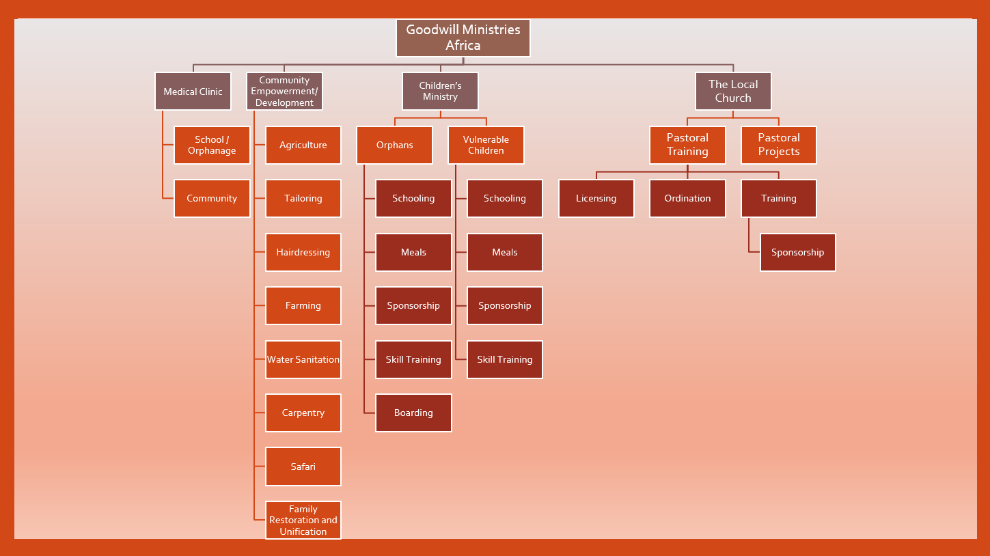

Slide 6
Medical Outreach
The Goodwill Medical Clinic is currently in development with a go-live goal for 2021.
The clinic will:
Be staffed with a Registered Nurse
Serve the children, teachers, and staff of Goodwill Ministries
Serve the surrounding community
The Goodwill Medical Clinic includes a triage/waiting area, exam room, pharmacy, lab, and two double occupancy patient rooms

Slide 7
Children’s ministry
Goodwill Ministries Africa serves vulnerable and orphaned children. The number of children varies from 100-200 children at any given time. The children's ministry serves by providing:
Housing
Education
Meals
Christian values
Goodwill Ministries Africa aims to keep families connected when possible. Some children stay and board at the orphanage because they are truly orphaned. Others are considered vulnerable children because they still live in the community, with a family member, but are at risk due to their current living or family situation. These children are welcomed for meals and schooling but return home instead of boarding at Goodwill.
*Sponsorship opportunities are available

Slide 8
Pastoral training
Pastoral training at Goodwill Ministries Africa is a high calling and a top priority. We believe communities can be transformed through relationship with God. It is our mission to train leaders, within the community, to formally pastor and lead churches in their own communities.
This ministry trains leaders by providing:
Onsite theological training
Resources to further their education and/or obtain certification/licensing/degree
Counseling and mentorship
*Sponsorship opportunities are available

Slide 9
Community empowerment
Goodwill Ministries Africa believes that sustainable change and a brighter future relies on an empowered community. Development, not just relief, is needed. Empowered communities are engaged and participating in their community goals. We aim to walk life together, lift each other up when the burden is heavy, and support each other until each person can stand on their own.
Several community empowerment projects have been started within this ministry but need ongoing support:
Tailoring
Farming/Agriculture
Hair Dressing
Carpentry
Safari
Family Restoration and Unification
*All teams visiting Goodwill Ministries Africa will participate in a Community Empowerment Project

Slide 10
Farming/ Agriculture
Farming Resources:
Goats
Cows
Chickens
Pigs
Sheep
Rabbits
Fish
Agricultural Resources:
Maize
Beans
Bananas
Avocados
Potatoes
Other crops based on planting season
The land is rich and fertile in Uganda. Farming and agriculture is used at Goodwill Ministries to help support the nutritional needs of the ministry as well as provide sustainable income.

Slide 11
How will you partner with our ministry?

Slide 12
Let’s start planning
6-12 months in advance
Team selection
Acquire passports
Begin fundraising (optional)
Schedule team meetings/team building time
6-9 months in advance
Secure airfare
Secure hotel reservations
Secure van rental (may be needed for larger teams)
3-6months in advance
Get vaccinations – Check the CDC website for recommended vaccinations when traveling to Uganda and speak with your physician (CDC.gov)
Get prescriptions (Malarone for malaria prevention and Cipro (optional) for travelers' diarrhea)
Purchase Ugandan Visa
This may be purchased at the Entebbe airport upon arrival, if not purchased in advance
1month in advance
Purchase travel insurance
Verify airline baggage requirements and determine packing guidelines for the team
(How many bags for personal use vs # of bags for team supplies, snacks, etc.)
Submit Team Itinerary Form to Goodwill Ministries, by email, no less than 1 month before the trip
Submit Goodwill Ministries Liability Form, for each team member, by email, no less than 1 month before the trip

Slide 13
Needed vaccinations/ Medications
Be prepared:
Visit an international travel clinic or consult with your family physician. Consult the CDC website for their current recommendations (Website: www.cdc.gov).
Typical vaccinations required:
Should be up to date on routine vaccinations, including tetanus
Hepatitis A
Typhoid
Yellow fever (must carry your yellow fever card with you at airport on arrival!)
Others based on physician or CDC recommendation
Cholera, Hepatitis B, Meningitis, Rabies, COVID
Medication:
Malaria medicine is needed before, during, and after your trip

Slide 14
Airfare
Arrival Airport : Entebbe, Uganda
Arrival: flights from the US typically arrive late in the evening (10-11 pm)
Departure: flights to the US also depart late in the evening (11 pm- Midnight)
Delta/KLM airlines are very reliable and are used often by teams traveling to work with Goodwill Ministries Africa. Other airlines are also available.
Cost of flights: $1200-$2000 per person, round trip (dependent on the time of year and where teams are flying from)
Humanitarian rates are available for mission teams
Example: Fly For Good International Airfare Experts @ Flyforgood.com

Slide 15
Passport & visa
Passport application (https://travel.state.gov)
Complete the form
Provide supporting documents
Provide passport photos
Pay fees (approx. $110 application fee and $35 execution fee)
Submit it all and wait (takes 1-3 months to process)
Visa Application (https://visas.immigration.go.ug)
Cost: $50

Slide 16
Travel insurance
Individual or group insurance
Plans vary but often cover accidental death and dismemberment, emergency medical expenses, emergency evacuation, trip cancellation fees, trip interruption fees, missed connection $, travel delay $, baggage and personal effect $, etc.
Cost: Typically, around $30 -$50 per person
Recommendation: Faith Ventures (faithventures.com)

Slide 17
Lodging and transportation
Van Rental:
Goodwill Ministries Africa has a 1passenger van that holds 6-7 adults and a truck that holds 5 adults (including driver)
Teams over 7 members will need to utilize a second vehicle
Recommendations for van rental available upon request
Ground Transportation/ Fuel Cost:
Round trip fuel between Entebee airport and Goodwill Ministries – includes pick up on arrival and drop off at departure = $400 per vehicle (divided between team members)
Other fuel expenses will be based off of the teams schedule/location of ministry projects
Guesthouse Recommendations:
Goodwill Ministries Africa Guesthouse
Approx. $20/night
Hotel Recommendations:
J. Residence Motel (stay here night of arrival)
Approx. $50/night, free breakfast, free Wi-Fi, airport shuttle
Website: jresidencemotel.com
Executive Airport Hotel
Approx. $50-$70/night
Website: Eahuganda.com
Banda Lodge- Masaka, Uganda
Approx. $50-$60/night
Website: banda.dk
Nabisere- Kalisizo, Uganda
Approx. $40-50/night

Slide 18
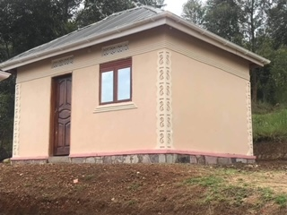
Goodwill Ministries africa guesthouse and cottages

Slide 19
Goodwill Ministries guesthouse and cottages
3 cottages
Double Occupancy
Guesthouse
Common Area
Dining space
Shared bathroom in each cottage
Shared closet
5 bedrooms
Room set up varies with bunk beds and/or full beds
Shared bathroom
Meeting space
Open- air with beautiful view
Cooking Space

Slide 20
Food/dining/Hydration
Breakfast: Plan on eating at the guesthouse, hotel restaurant or eat packed snacks
Lunch: Lunch may be eaten on site or packed lunches can be taken with you
Plan to pack filling snacks:
Carry several food items with you throughout the day. Examples include beef jerky, granola bars, breakfast bars, dried fruit and nuts, peanut butter, crackers with cheese or peanut butter, trail mix, etc.
Late dinner: Hotel restaurant or guesthouse (often around 8 pm or later)
Hydration: Plan on buying cases of bottled water once in country
Bring mix in packets for variety (lemonade, Gatorade, etc.)
Only drink bottled water/pops – take caution with restaurant fruit juices/coffee because they are often mixed with tap water
Avoid dehydration – Drink more water than you typically do at home

Slide 21
Other expenses to consider
Visa cost (if not purchased ahead of time)
Additional food: Meals and drinks during airport/travel days
Tips: Drivers, servers and/or hotel staff
Souvenirs: Varies per person
Optional leisure day: Safari Park day trip
Project expenses: Cost varies based on team project(s)

Slide 22
In-country host contact info
Custom Form Completion:
*Important* For more specific information on how to complete the customs form please visit https://www.ugandamission.net/travel/air/customs.html
Write needed info on a 3x5 card and provide to all team members
Host name: Edward Ombewa Mbuyi
Host phone number:+256 775 878 797
Email address: embuyi12@gmail.com, goodwillmissions01@gmail.com
In-country address: Goodwill Ministries Africa, PO BOX 1289, Masaka, Uganda

Slide 23
Contact Us
Please contact us with any further questions or concerns by email, phone or text:
General email:
Goodwillmissions01@gmail.com
Individual email:
Edward Mbuyi: embuyi12@gmail.com
Mica Fensler: micafensler@msn.com
Phone/Text:
Mica Fensler: 260-438-4347 (US)

